Slide 1
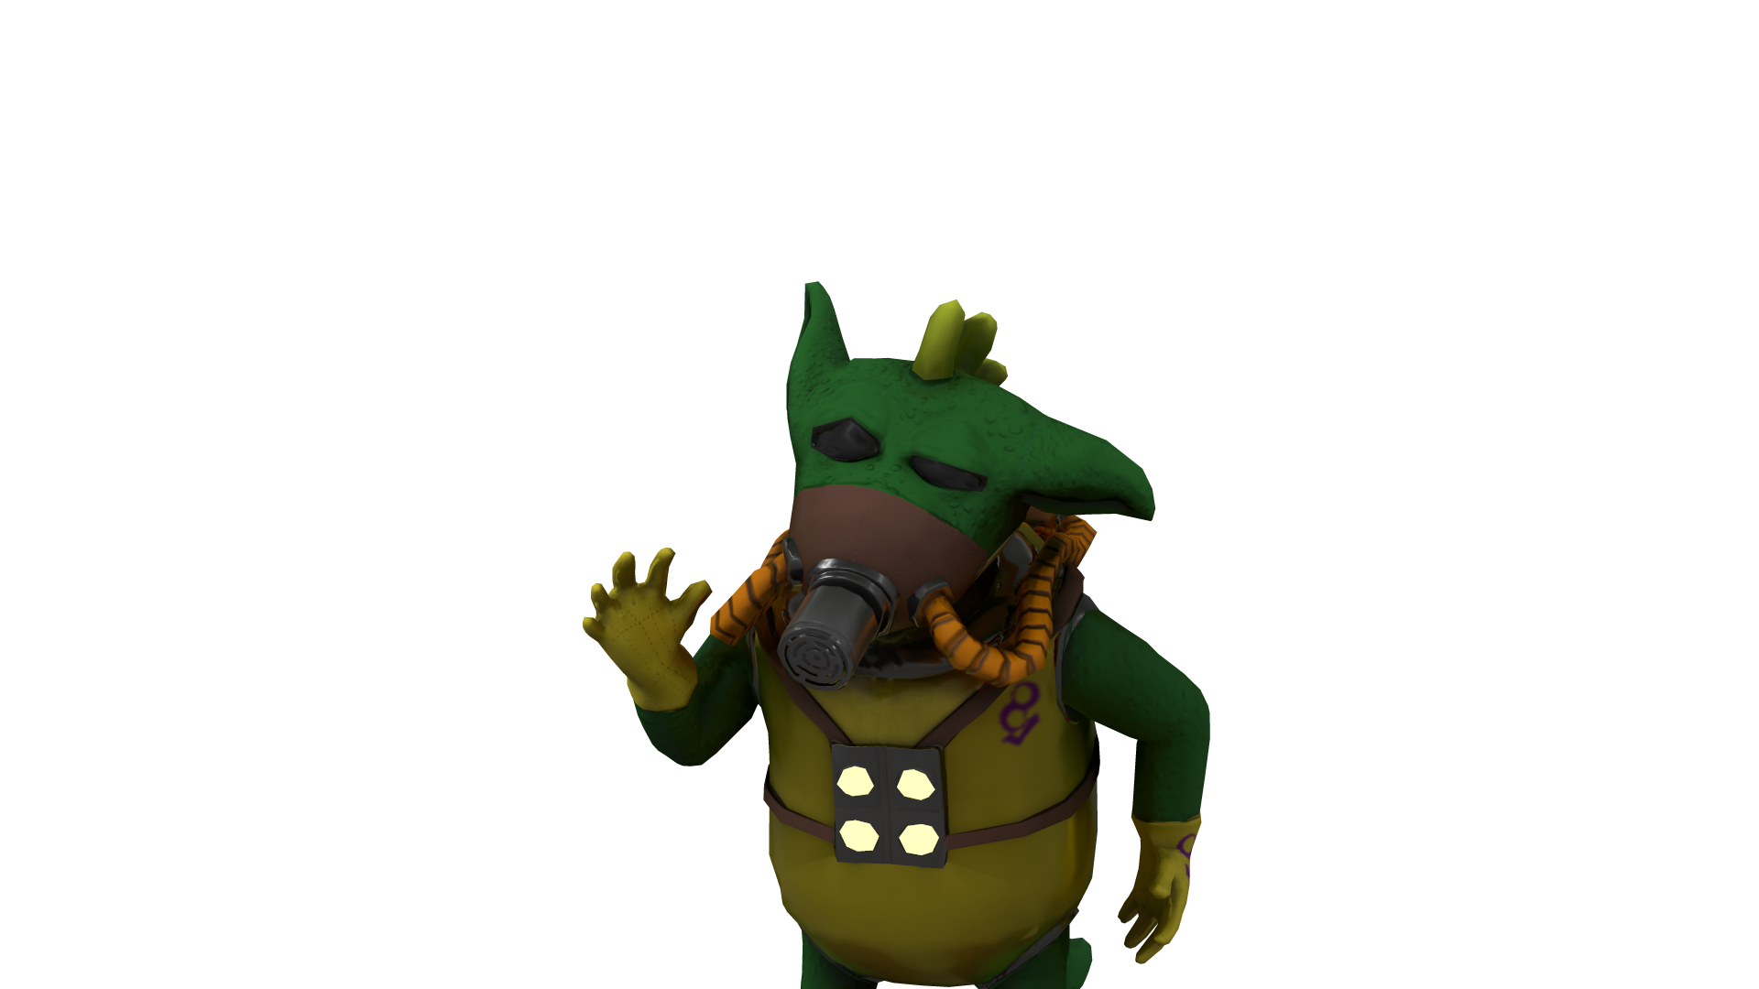
Grounded!
PointLight Inc.

Slide 2
Team Roles
Joshua Pritchard - Team lead / Systems/Scripting Development.
Jordan Andrews - Game Systems/Scripting Development.
Atikarn Tungisarapap - Game Systems/Scripting/UI/UX Development.
Aaron Cant - Art Lead / Character Rigging & Animation / Asset Design.
Vitalija Lukoseviciene - Character Modelling/Design.
Brad Lagota - Prop/UI/Environmental Design.
Callum Golden - Asset Design / Soundscaping.

Slide 3
Elevator Pitch
All was fine for J.J. Vabac the Alien, cruising through hyperspace, until his Ship malfunctioned and sent him plummeting straight into a suspiciously empty city!
When he awoke, J.J. was fine, but his ship, and seemingly the planet around him, was definitely not. A quick glance to the instruments console told him the atmosphere on the planet’s surface was unbreathable!
J.J. must brave the dangers he faces however, and find the parts he needs to repair his ship and get home!
Grounded! Is a cute, content heavy game with infinite replayability that will challenge you and your ship repair skills to their absolute max!

Slide 4
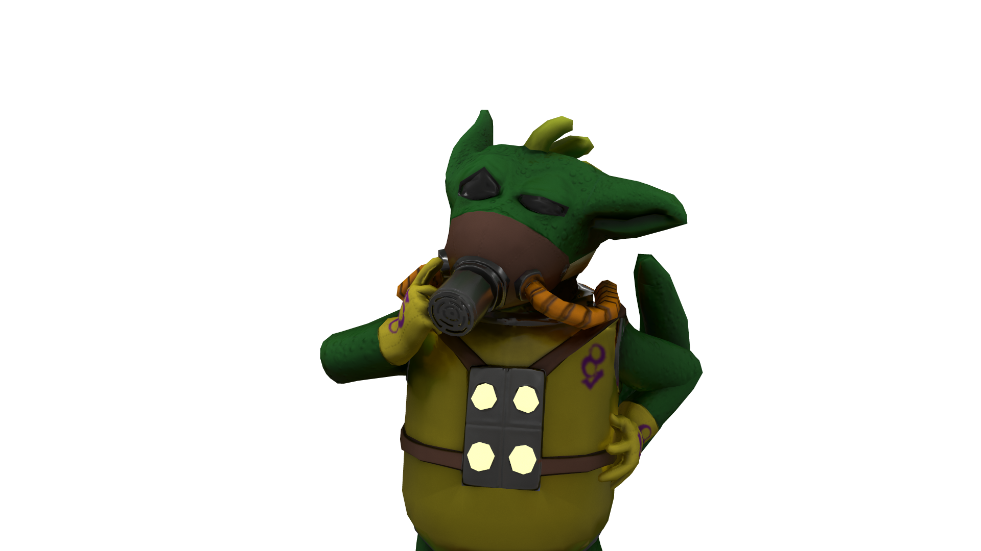
Why did we pick this game?
Proc Gen.
Interleaved Mechanics.
Simple to understand concept.
Stranded Theme - technical twist.
Niche Theory
Straightforward artstyle
Room for artistic flair.

Slide 5
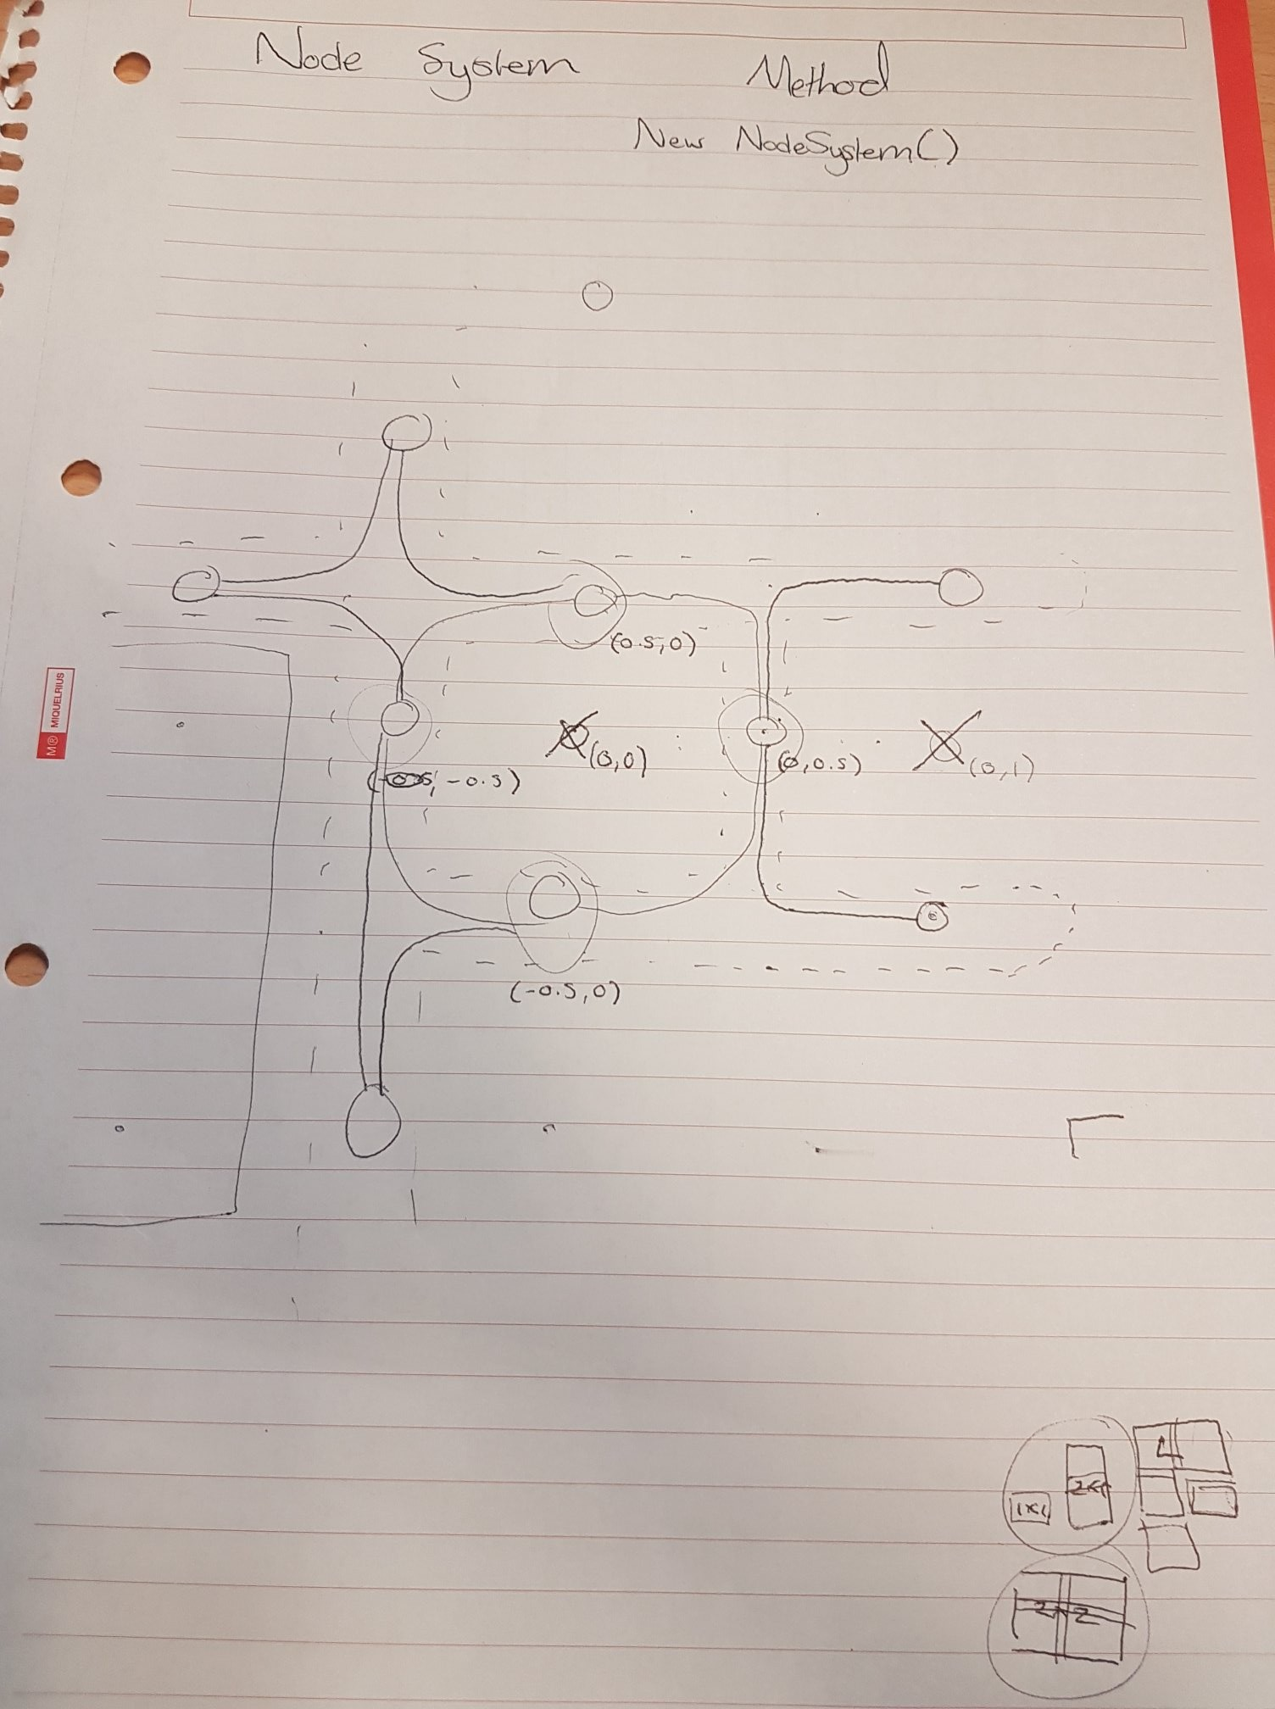
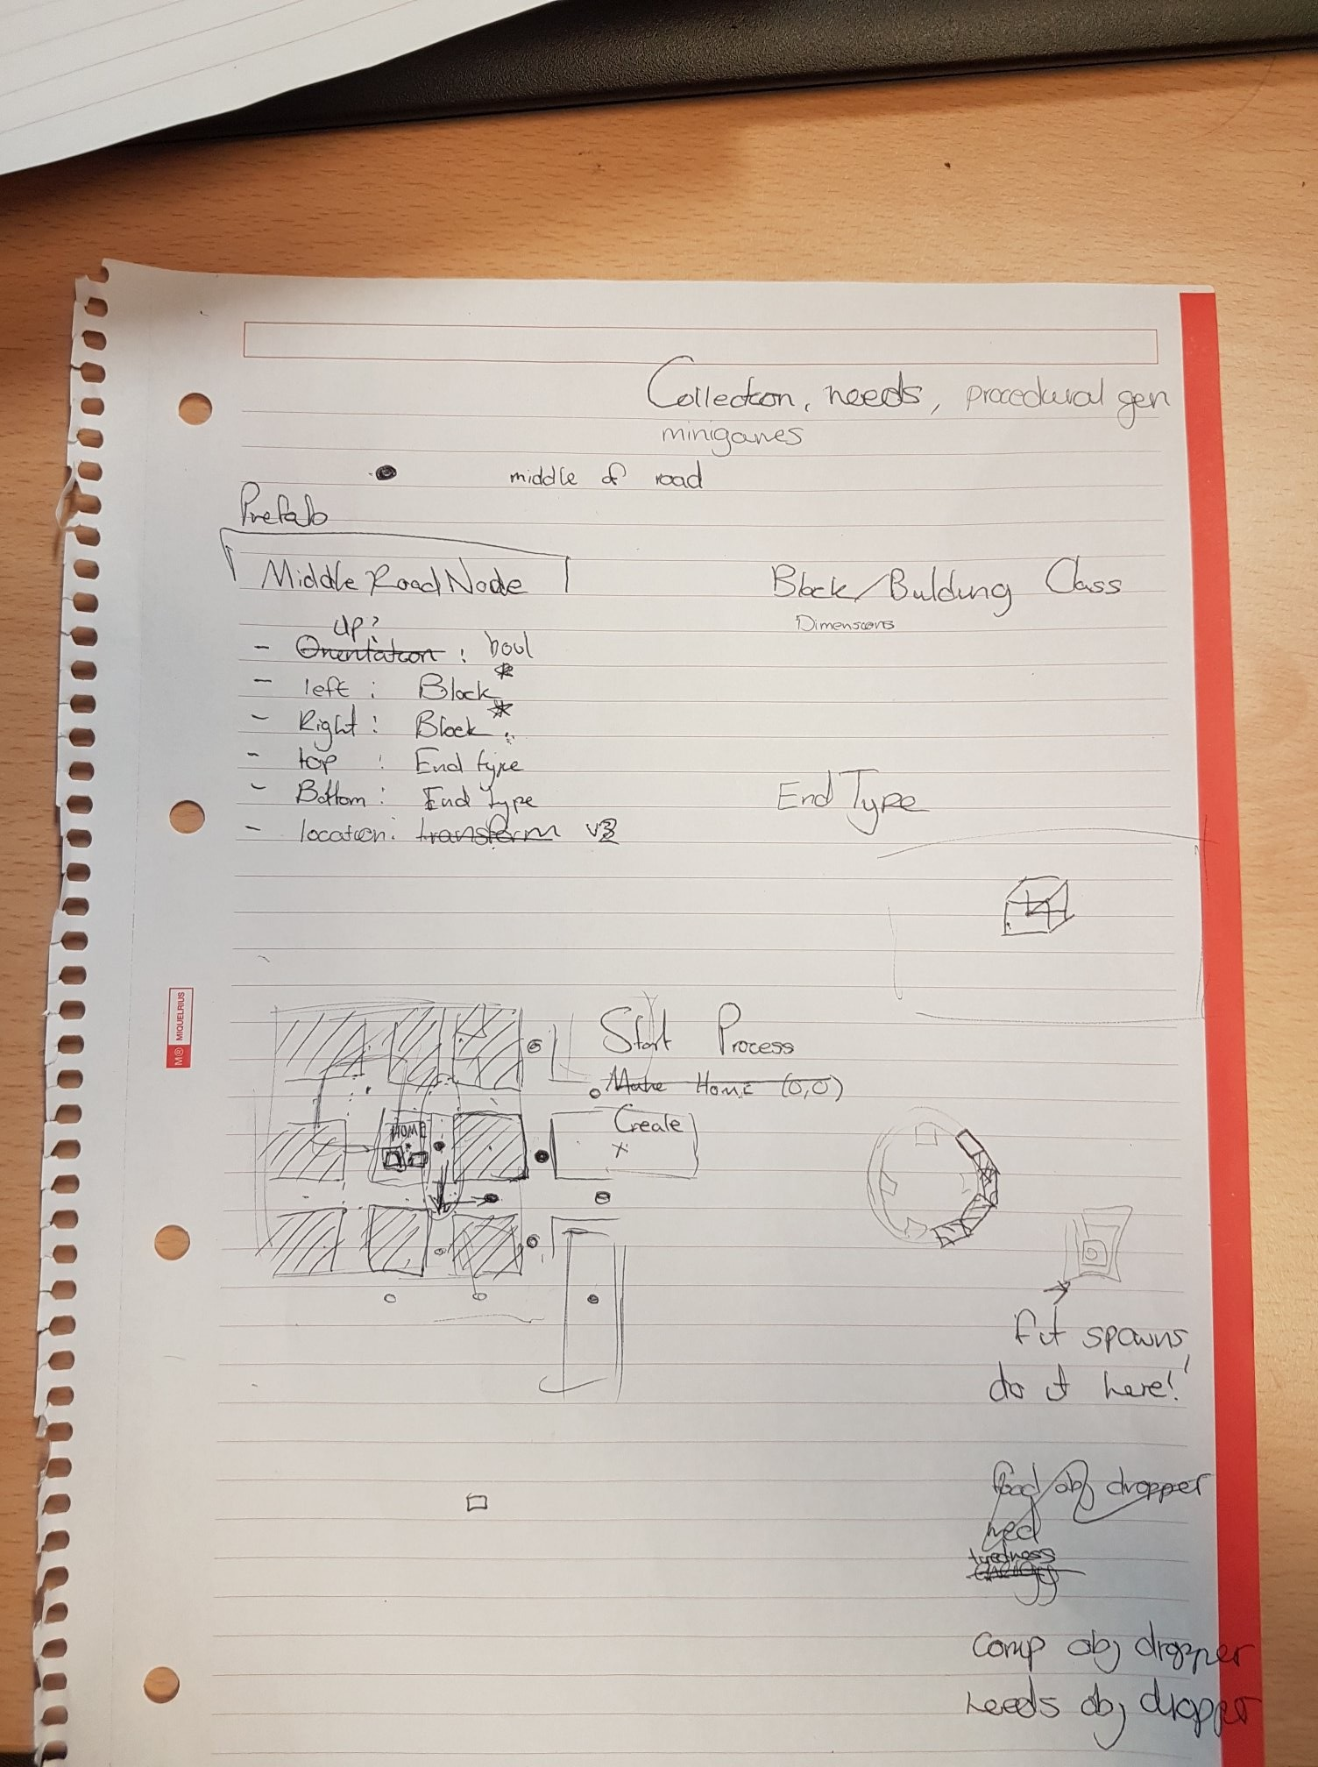
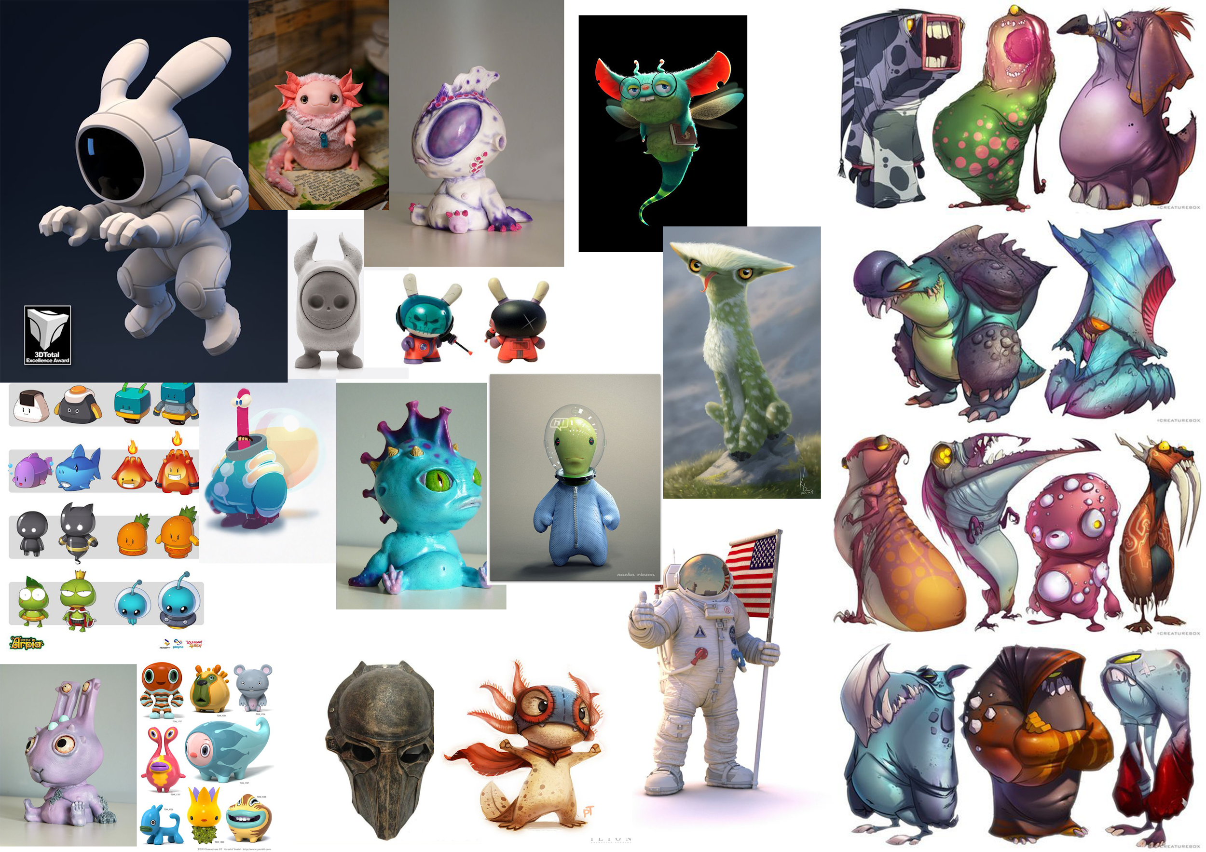
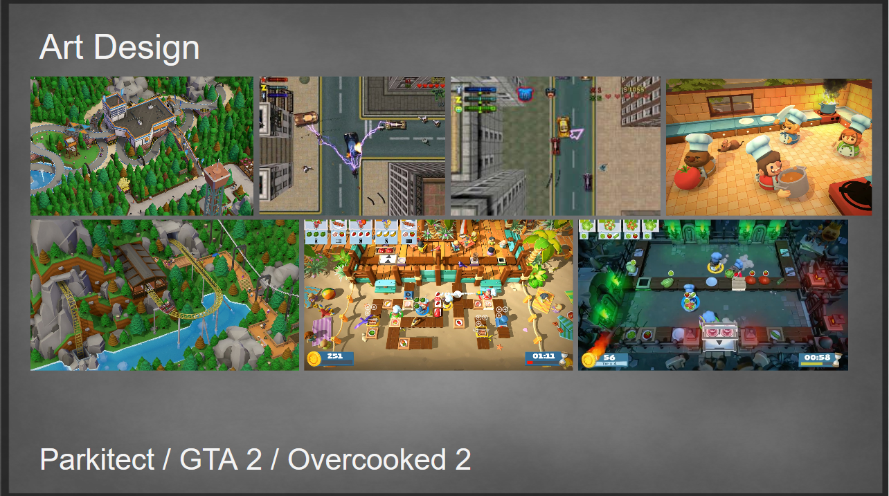
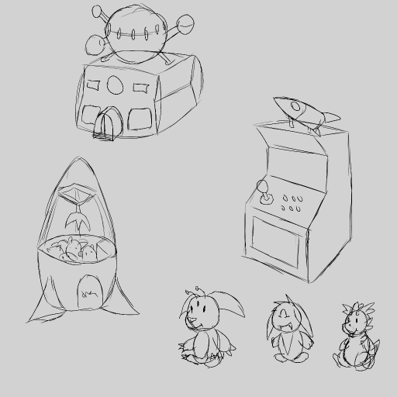
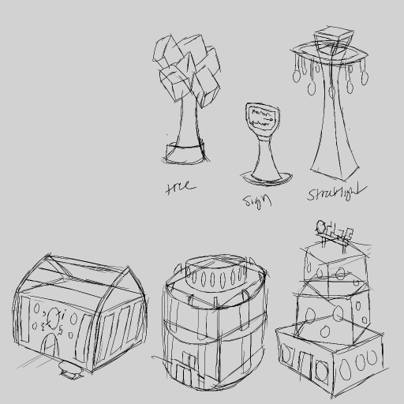
Concepts.
Programming plans.
Art concepts.

Slide 6
Project planning overview
Meeting
Monday Feature definition.
Task definition between disciplines.
Programming
Trello: Spec, Implement, Bug Fix, Polish, Finish.
Plan Game Systems.
Meetings kept progress coherent.
Google doc to document progress.

Slide 7
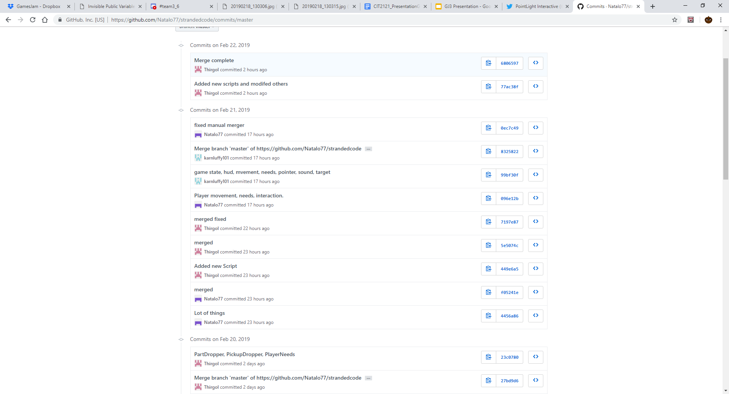
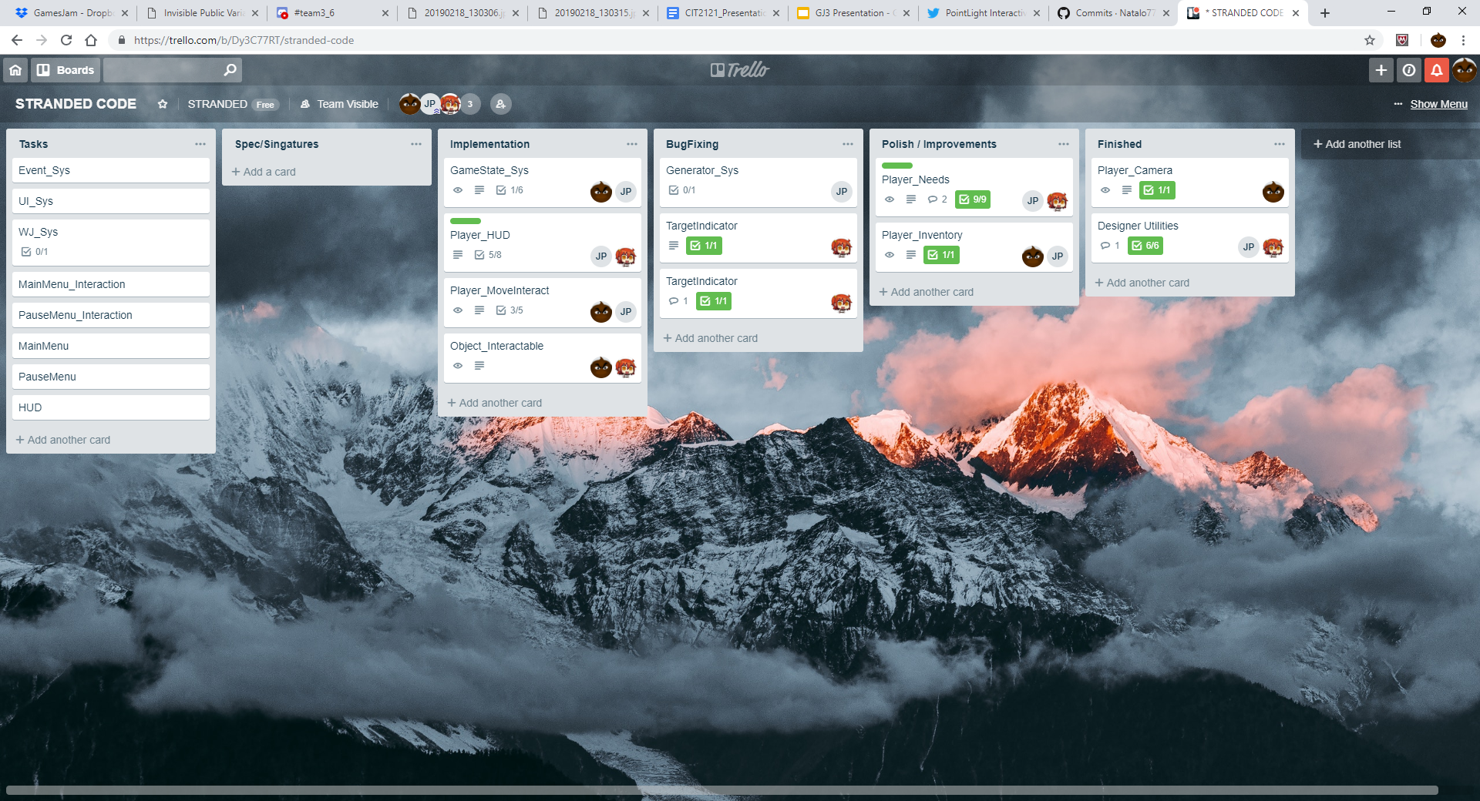
Tools used.
Github.
Unity / C#.
Trello

Slide 8
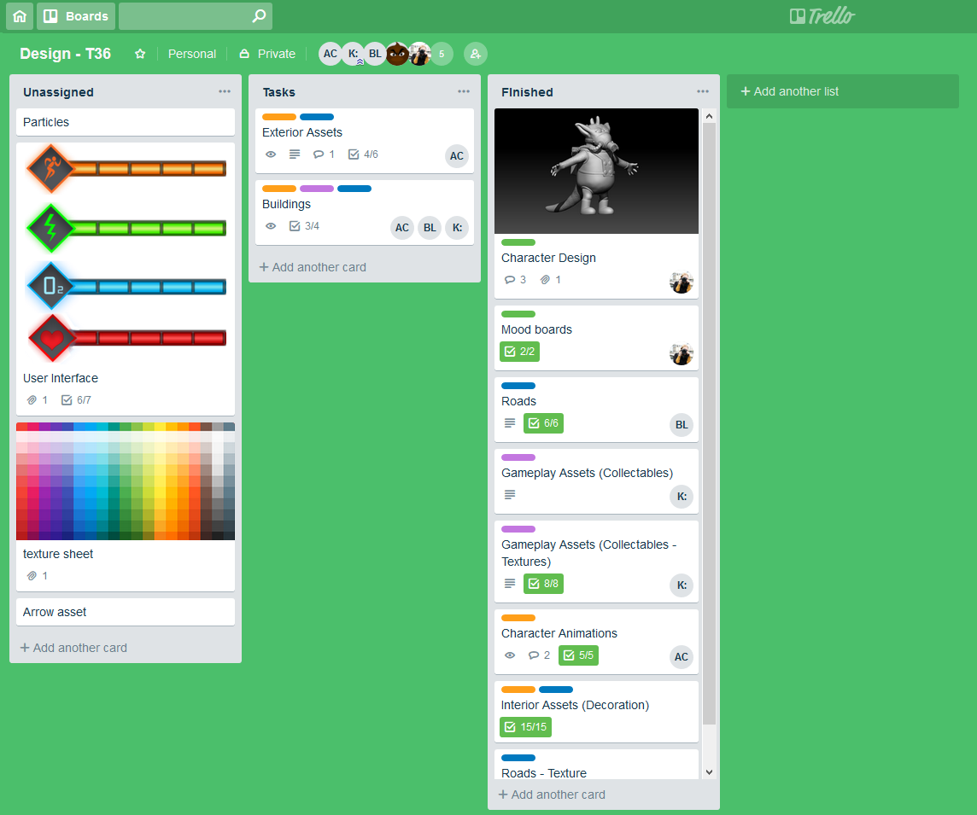
Primary Design Tools used:
3DS Max.
ZBrush.
Audacity.
Photoshop.
Trello
Marmoset Toolbag 3
XNormal

Slide 9
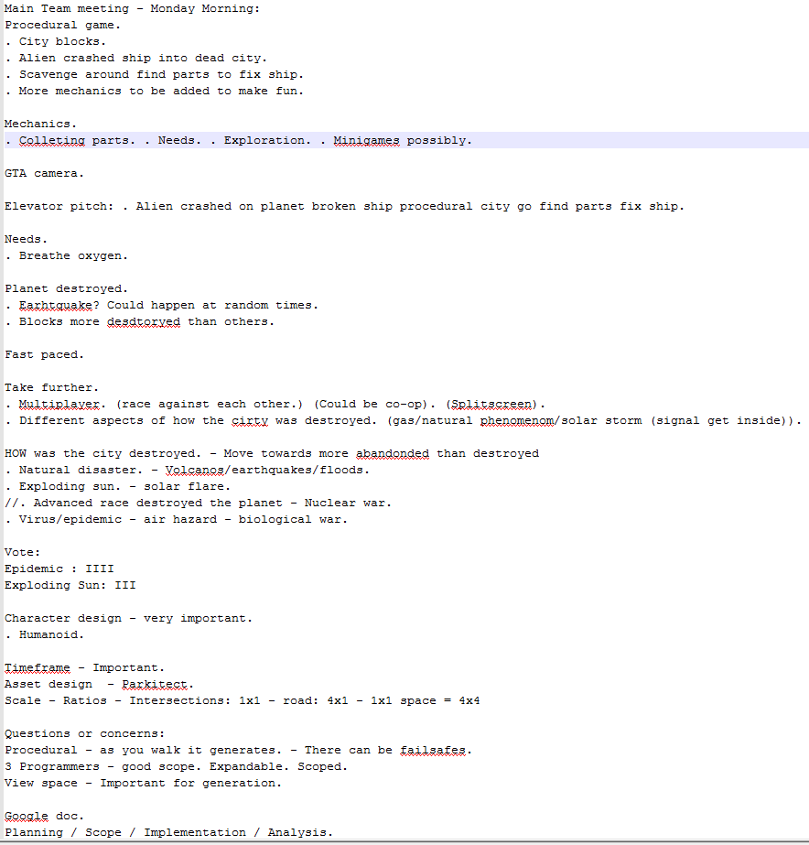
Meetings.
Team meetings (Monday/As and when)
Fleshed out
Ideas.
Questions.
Concerns.

Slide 10
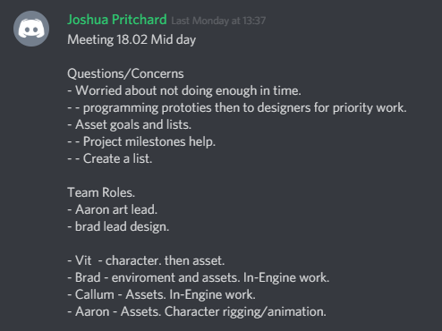
Work assignments
Design Roles.
Assigned roles based on preference at start of week
Design priorities.
Prioritised getting base content (One of each building type, character model, gameplay-centric props) completed first
Re-allocation for milestones

Slide 11
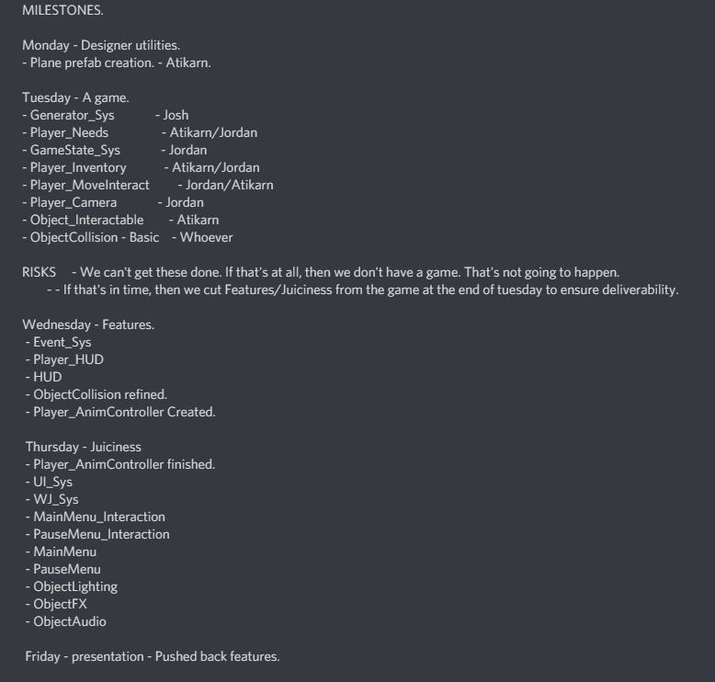
Scope
Two main mechanic scope.
Monday Task allocation
Modular procedural artistic variety.
Time scales.
Programming defined.
Wednesday - Game loop finish

Slide 12
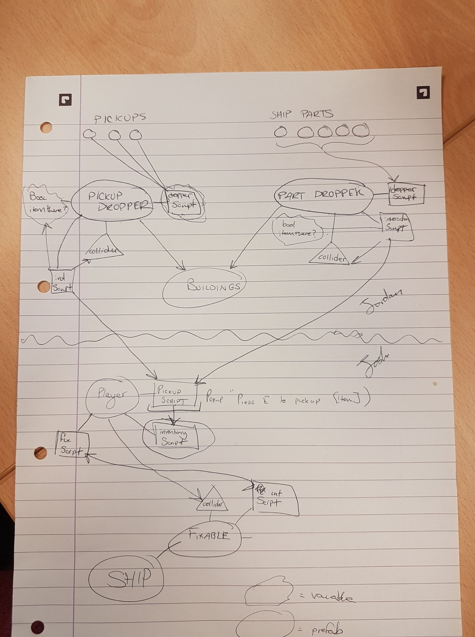
Programming.
Proc Gen.
Inventory.
HUD.
Fixables.
Game System vs. Scripts.
Master version QA & Testing
Github
Stretch goals. (Wednesday game loop)

Slide 13
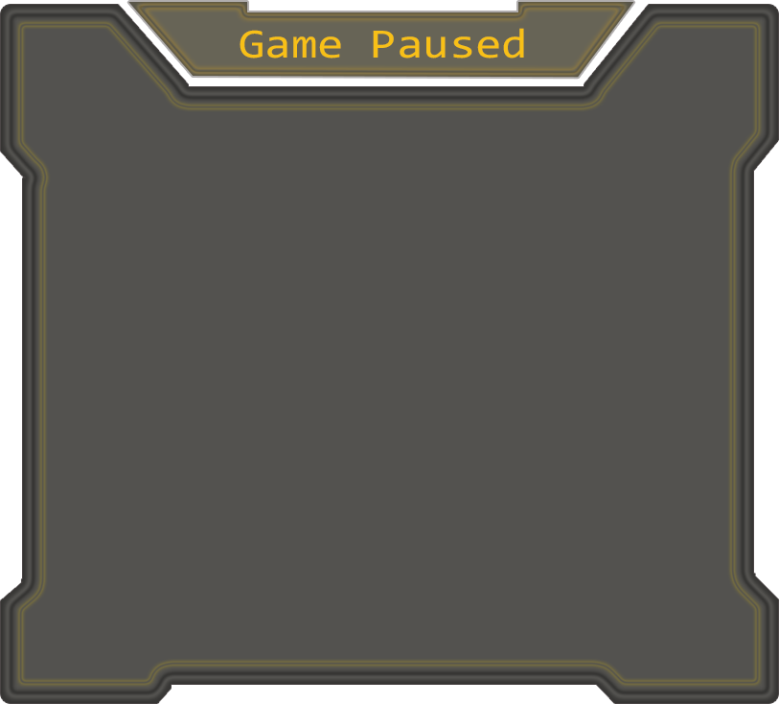
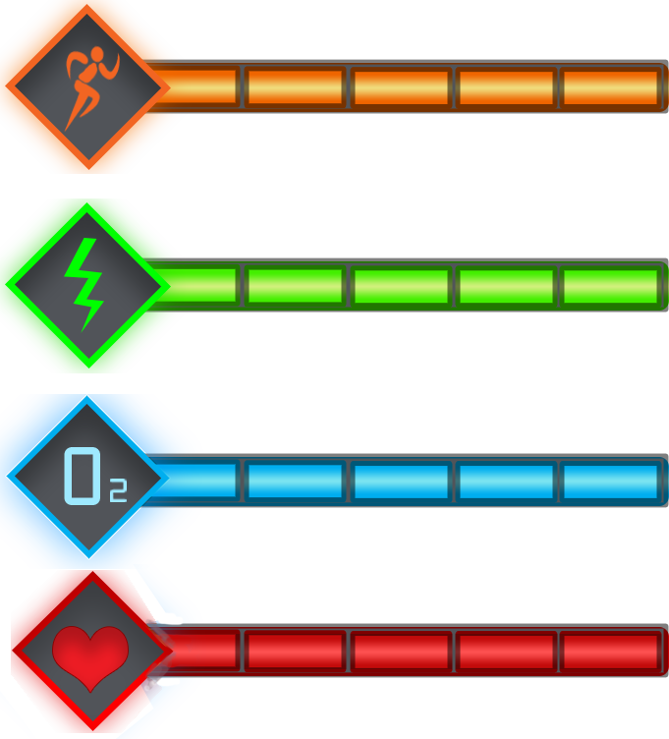

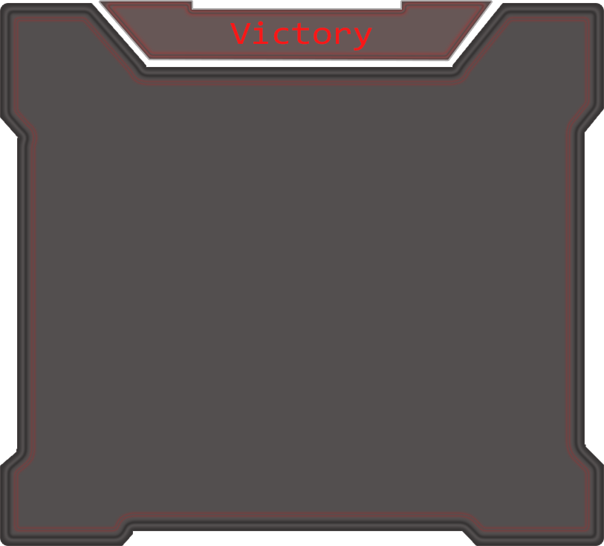
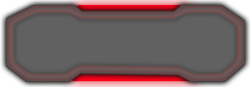

UI/HUD
Simple & Readable
Associated with needs:
Energy
Power
Oxygen
Health

Slide 14
Player Interaction
There are many scripts that come together to implement the player interaction.
These scripts mostly consist of trigger enter, stay and exit events with checks for the object they are interacting with.
The player interaction also includes communication to the inventory.

Slide 15
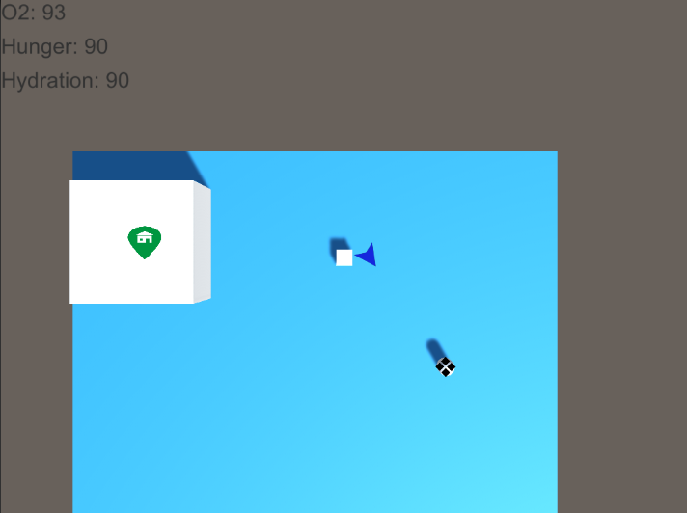
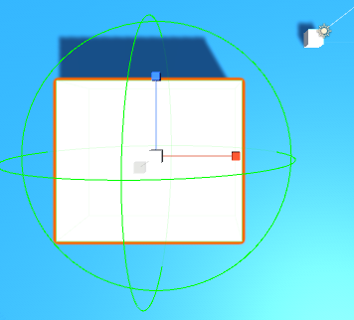
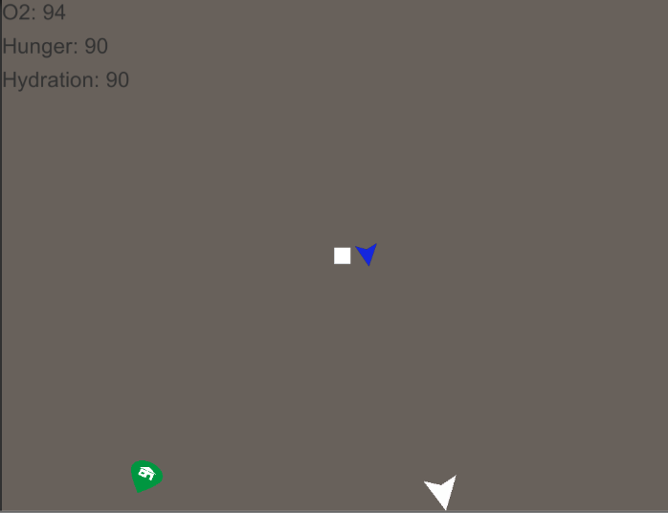
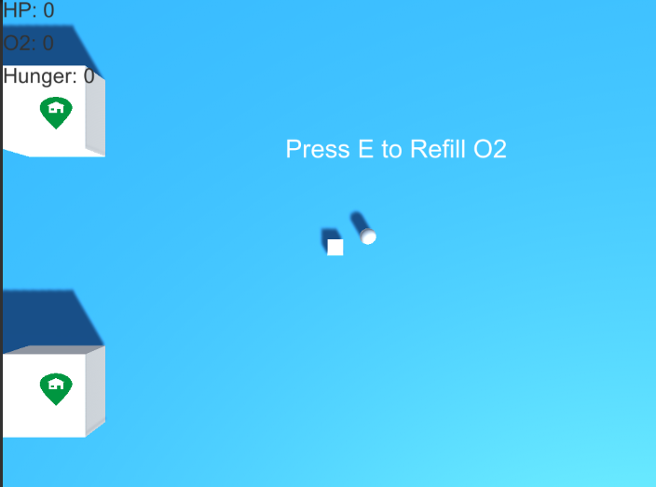
TargetIndicator
On/Off screen target indicator - This will indicate a target on a screen wherever the player go.
Wire sphere

Slide 16
Lead Design
Allocated roles on preference
Set realistic milestones
Roles carried throughout the week
Kept up to date with tasks

Slide 17
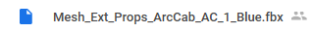
Art lead. (Workflow implications)
Discussed and finalised design direction for assets before creation
Buildings designed with multi-use-potential (mostly)
Attempt to establish naming convention
Most assets implemented at end of wednesday

Slide 18
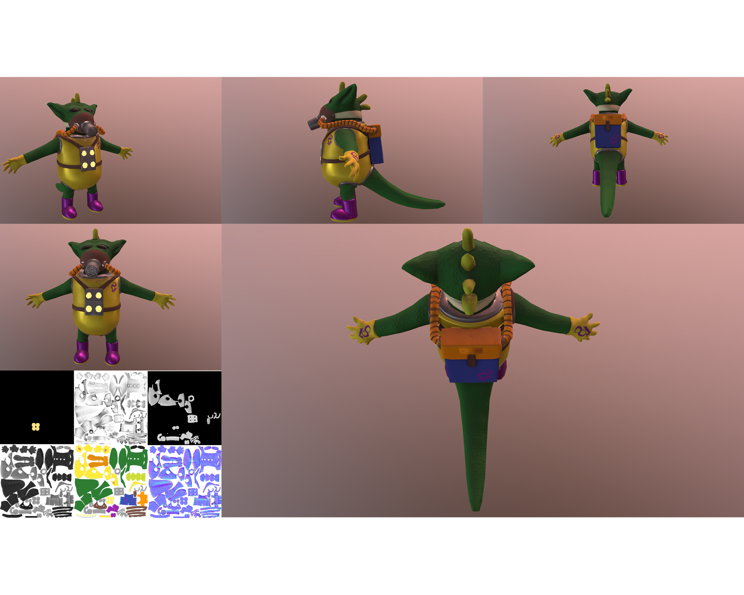
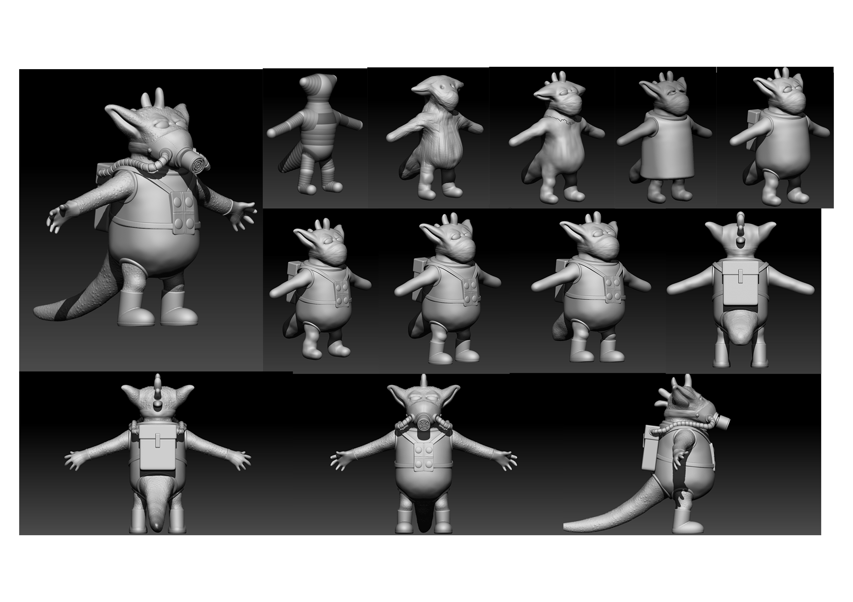
Character

Slide 19
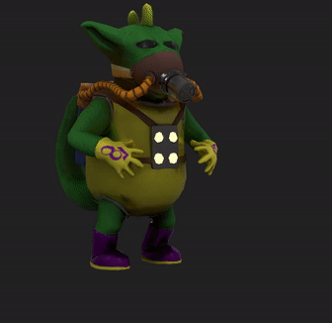
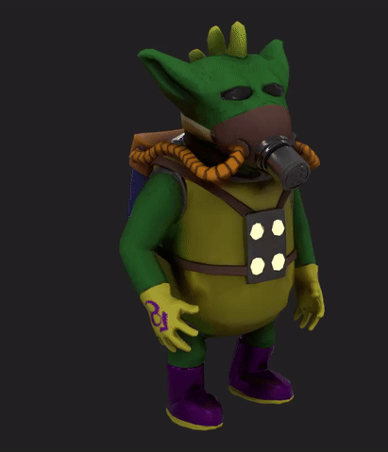
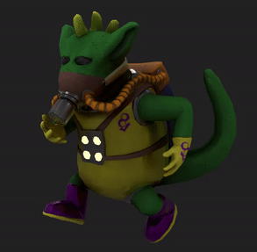
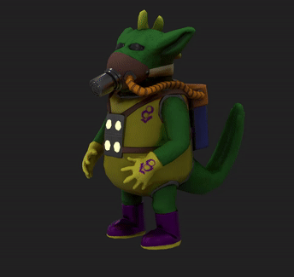
Character Animation
CAT Rig/Animations created after UV process
Made in parallel with the texture completion

Slide 20
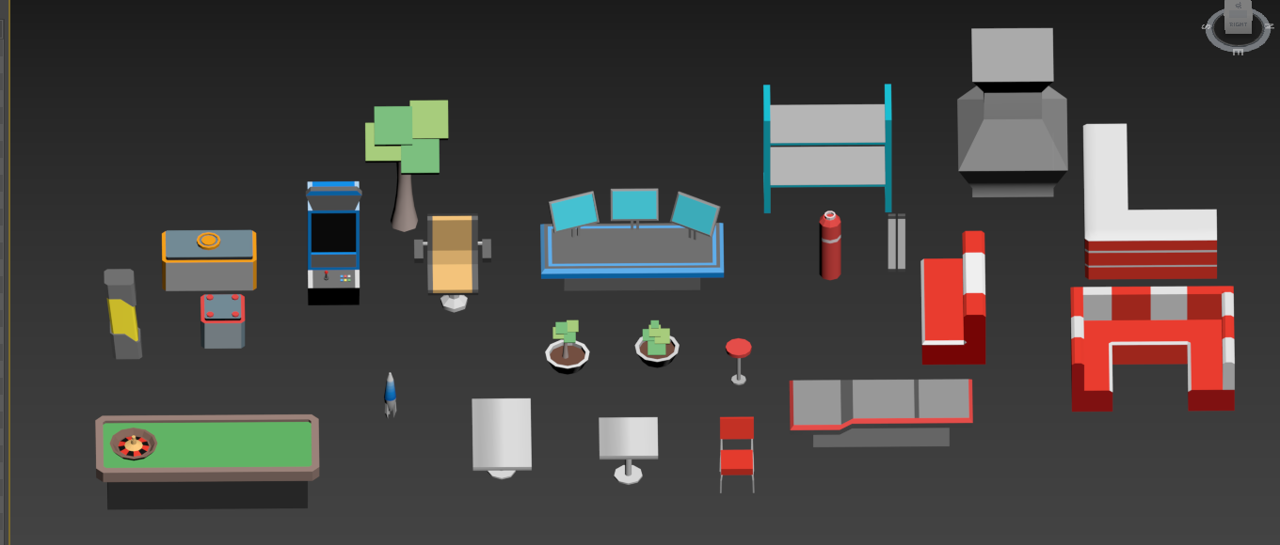
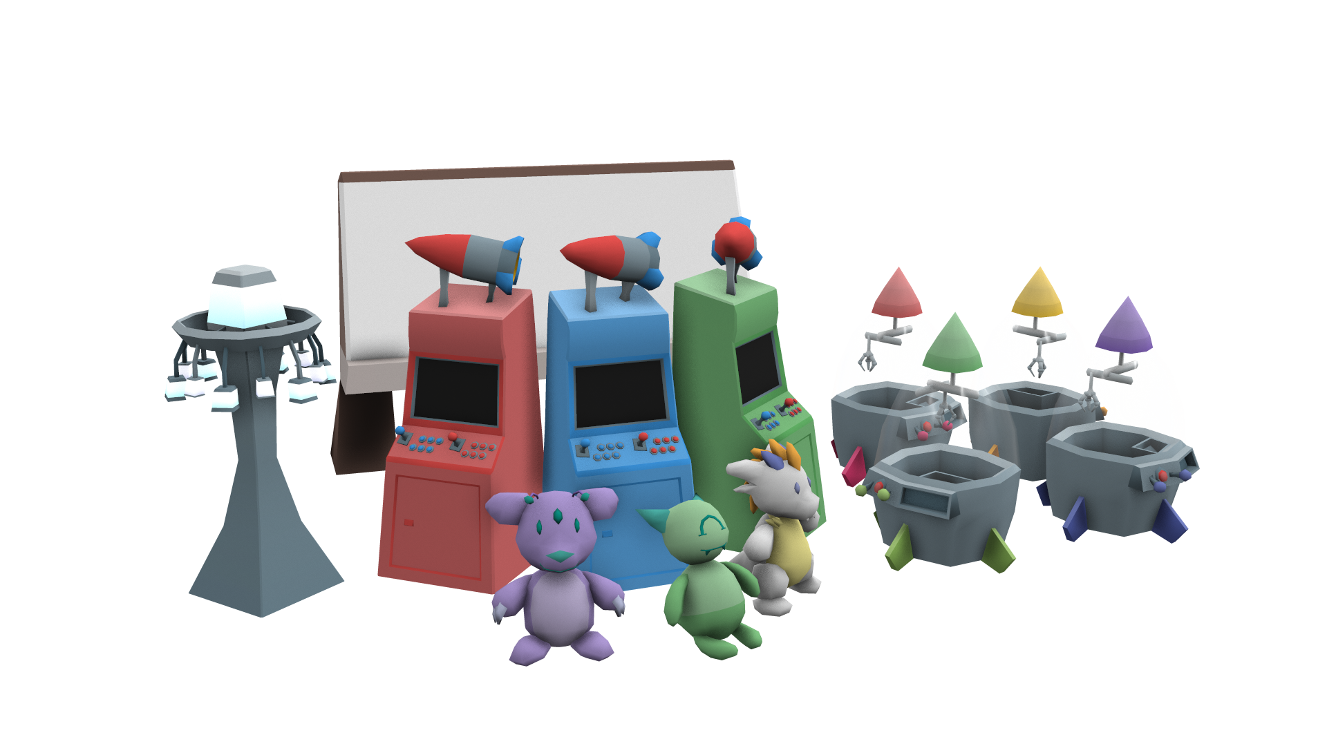

Props
Low poly models with flat colour art style.
All assets were textured using a single texture.
We were able to produce a sizable asset library fairly quickly and efficiently this way.

Slide 21
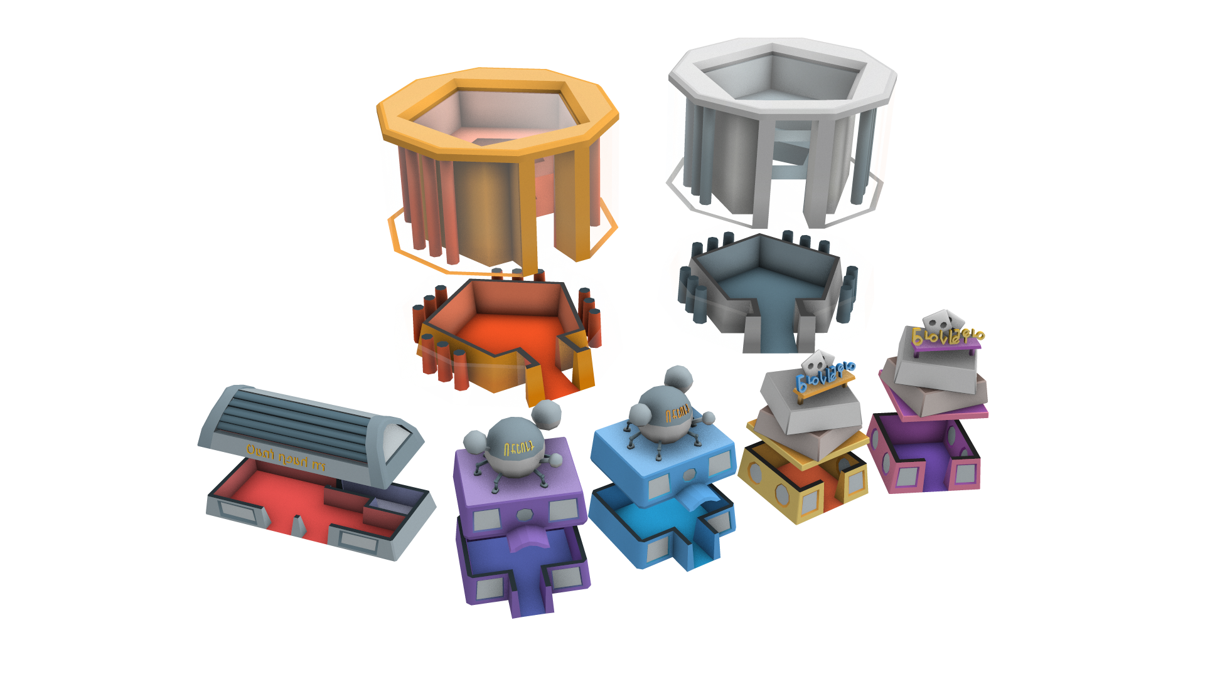
Buildings
Four building sizes
Same design philosophy as props
Model split into two distinct sections
Top hidden when player enters

Slide 22

What went well
Coherent team direction.
Diverse and mostly feature complete game.
Consistent art direction.
Robust and re-usable systems.
Learnt from each other.
Task allocation

Slide 23

What went wrong.
Getting everything in engine.
Game loop was late meaning polish had to happen in parallel.
Texturing style not communicated well
Github merging.
Scaling problems in engine.

Slide 24
What we have learned.
Having someone to work in editor is massively helpful.
Regular commits and pushes with minimal overstep is crucial.
BE VERY CAREFUL WITH MERGE CONFLICTS.
Pivot points.

Slide 25
Questions?

